Slide 1
Project Name
Regional Sale Analysis
Problem Statement
Analyse Acme Co’s 2021-2025 data to identify key revenue and profit drivers across products, channels and regions; uncover seasonal trends and outliers; and align performance against budgets. Use these insights to optimize pricing, promotions and market expansion for sustainable growth and reduced concentration risk.

Slide 2
Dataset Overview
This analysis is based on a Regional Sales Dataset consisting of multiple related tables that capture sales transactions, customer details, product information, and regional attributes. The dataset provides a comprehensive view of sales performance across different regions, products, and customer segments.

Slide 3
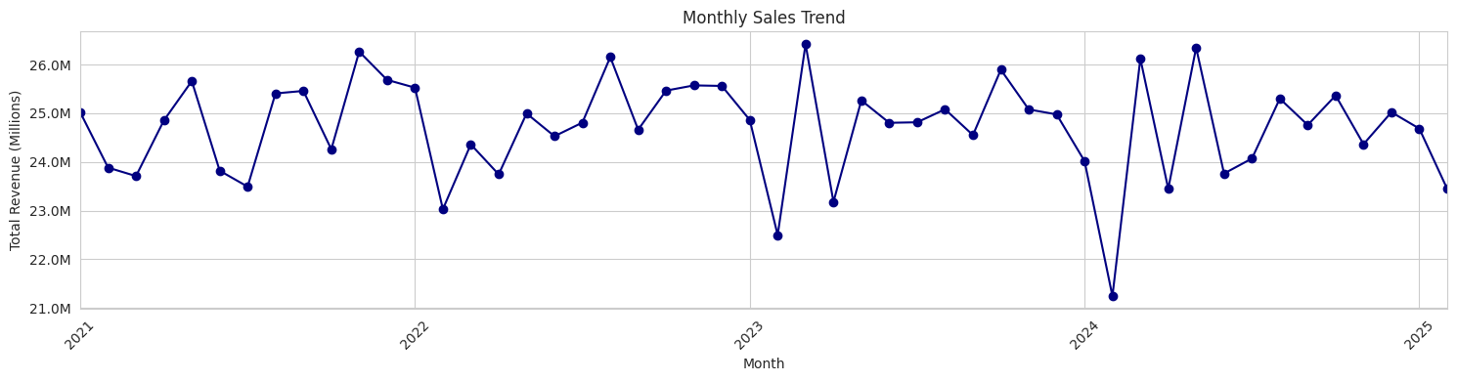
Time Series Analysis
Findings :-
Sales consistently cycle between $24M and $26M, with clear peaks in late spring to early summer (May – June) and throughs each January.
The overall trend remains stable year over year, reflecting a reliable seasonal demand pattern.
The sharp revenue drop in early 2024 stands out as an outlier, warranting closer investigation into potential causes such as market disruptions or mistimed promotions.

Slide 4
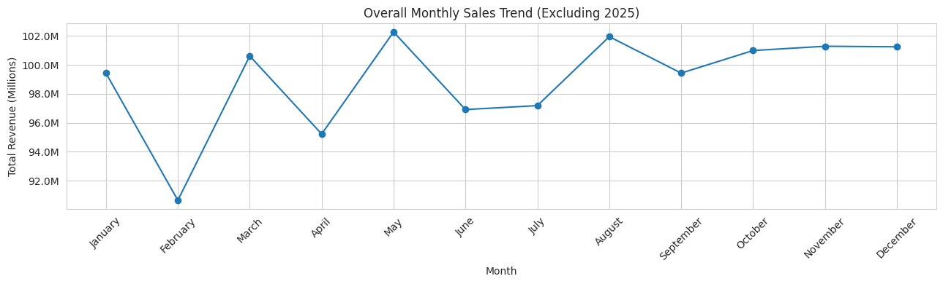
Time Series Analysis
Findings :-
Across all years, January begins strong with roughly $99 M, followed by a steep decline through April’s low point ($95 M).
Sales rebound in May and August ($102 M) before setting into a plateau of $99 – 101 M from September to December.
This pattern reveals a strong post-New Year surge, a spring dip, and a mid-summer bump each calendar year.

Slide 5
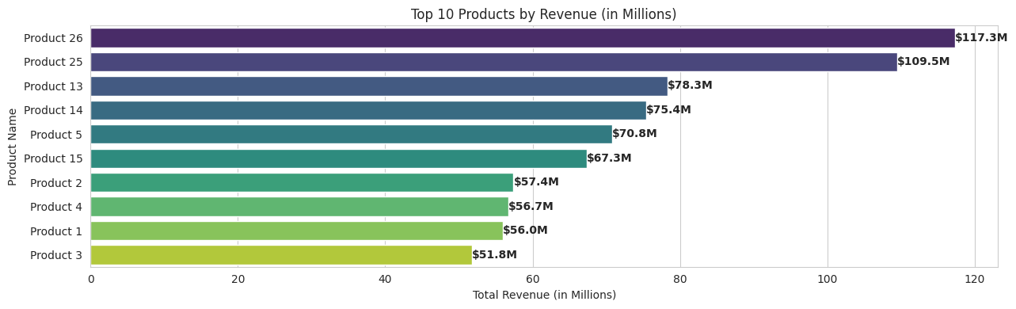
Univariate Analysis
Findings :-
Products 26 and 25 pull away at $117 M and $110 M, with a sharp drop to $78 M for product 13 and a tight mid-pack at $68-$75 M.
The bottom four cluster at $52-$57 M, highlighting similar constraints.
Focus on growth pilots for the mid-tier and efficiency gains for the lower earners to drive significant lifts.

Slide 6
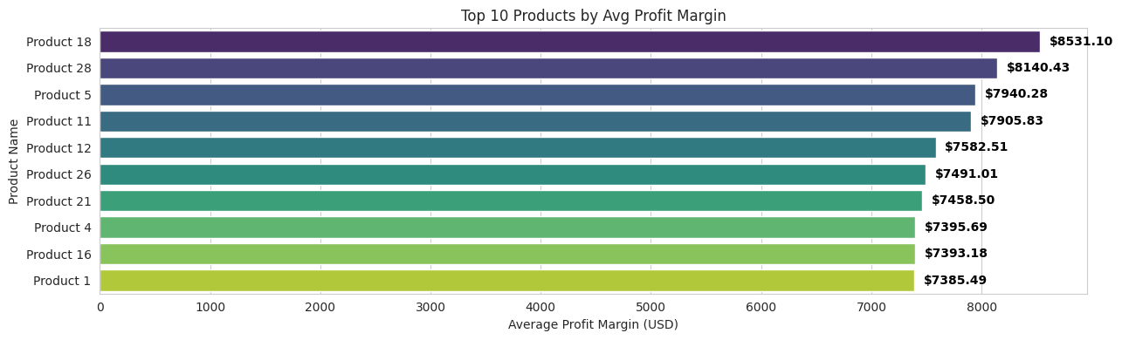
Univariate Analysis
Findings :-
Products 18 and 28 lead with average profit margins of approximately $8.0-8.3 K, followed closely by product 5 and product 11 around $7.9-8.0 K.
Mid-tier performers like products 12,26 and 21 cluster in the $7.7-7.8 K range, while the bottom tier (products 4, 16 and 1) fall between $7.4-7.6 K.
Focusing on margin optimization strategies from top performers may help elevate overall product profitability.

Slide 7
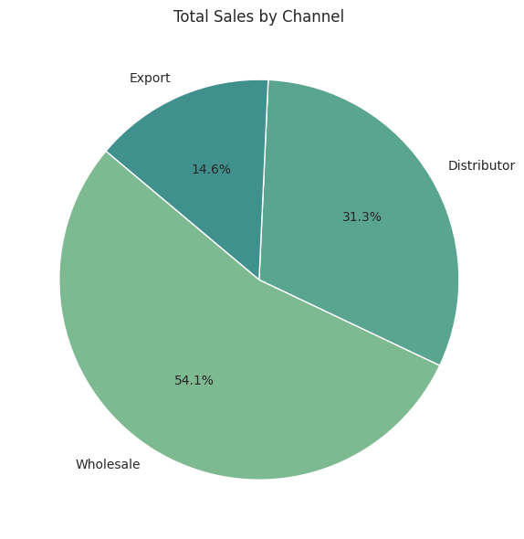
Univariate Analysis
Findings :-
Wholesale accounts for 54 % of sales, with distribution at 31 % and the exports at 15 %, underscoring reliance on domestic bulk channels.
To diversify revenue and mitigate concentration risk, prioritize expanding export initiatives – through target overseas marketing and strategic partner relationships.

Slide 8
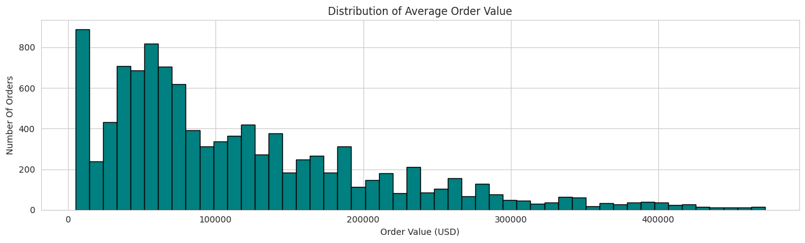
Univariate Analysis
Findings :-
The order value distribution is heavily right-skewed, with most orders clustering between $20 K and $120 K and a pronounced mode around $50 K - $60 K.
A long tail of high-value transactions extends up toward $400 K-$500 K, but these large orders represent only a small share of total volume.

Slide 9
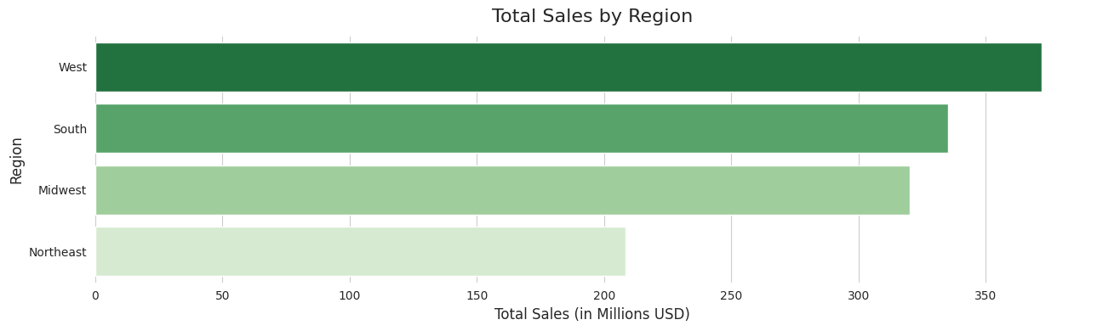
Univariate Analysis
Findings :-
West dominates with roughly $360 M in sales (~35% of total), underscoring its market leadership.
South & Midwest each contribute over $320M (~32%), indicating strong, consistent demand across central regions.
Northeast trails at about $210M (~20%), signalling room for growth and targeted investment.
Action : Focus on closing the Northeast gap with local promotions and strategic partnerships, while maintaining national playbook success.

Slide 10
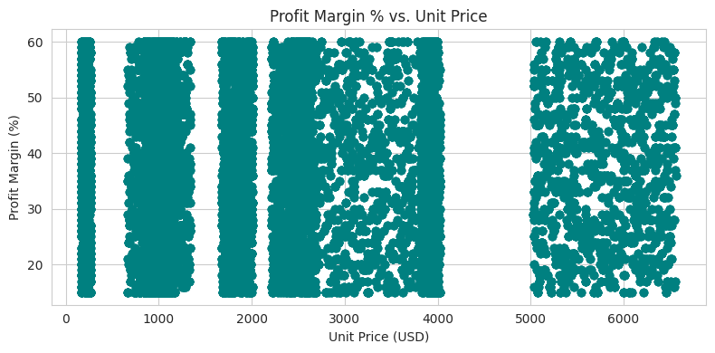
Bivariate Analysis
Findings :-
Profit margins are concentrated between ~18% and 60%, with no clear corelation to unit price, which spans from near $0 to over $6,500.
Dense horizontal bands indicate consistent margin tiers across a wide price spectrum, reflecting uniform pricing strategies.
Outliers below 18% at both low and high price points may signal cost inefficiencies or pricing issues worth deeper investigation.

Slide 11
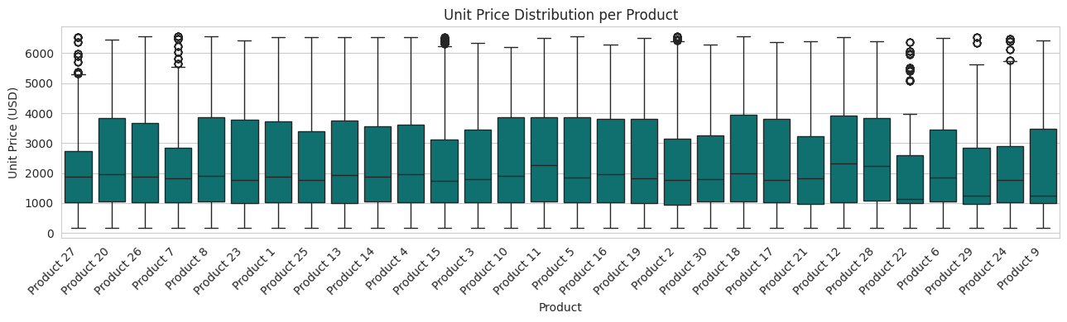
Bivariate Analysis
Findings :-
Products 8, 17, 27, 20 and 28 show high-end revenue spikes – well above their upper whiskers – likely due to bulk orders or premium bundles that temporarily inflate earnings.
In contrast, deep low-end outliers (near $0-$100) on products 20 and 27 suggest promotional giveaways or test SKUs that pull down average prices.
To ensure accurate margin and pricing assessments, exclude these outlier transactions from average calculations.
These assess whether such anomalies warrant formalization as ongoing promotional strategies or should be phased out to stabilize pricing performance.

Slide 12
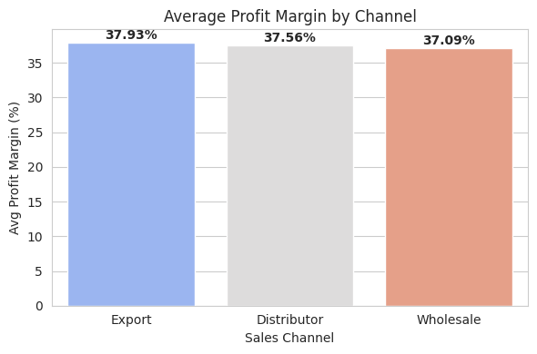
Bivariate Analysis
Findings :-
Export leads with a37.93 % average margin, closely followed by Distributor (37.56%) and Wholesale (37.09%)
The tiny spread (<0.2%) shows consistently strong profitability across all channels.
This uniformity implies well-controlled costs and pricing power everywhere.
To maximize returns, push volume growth in export while maintaining efficiency in Distributor and Wholesale.

Slide 13
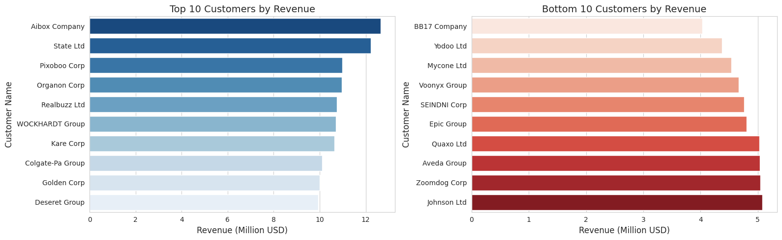
Multivariate Analysis
Findings :-
Aibox company tops the list with $12.5M, followed closely by state Ltd ($12.2M), while the 10th-ranked Deseret Group contributes $9.9M – demonstrating a tight $10-12 M top tier.
At the bottom, Johnson Ltd leads its group with $5.1 M, down to BB17 company at $4.1M – roughly half the top customer’s revenue.
This steep drop from ~$10M+ to $4-5M highlights high revenue concentration among the top customers.
Action : Prioritize retention and upsell for your top ten, and launch targeted growth campaigns to elevate the lower-revenue cohort.

Slide 14
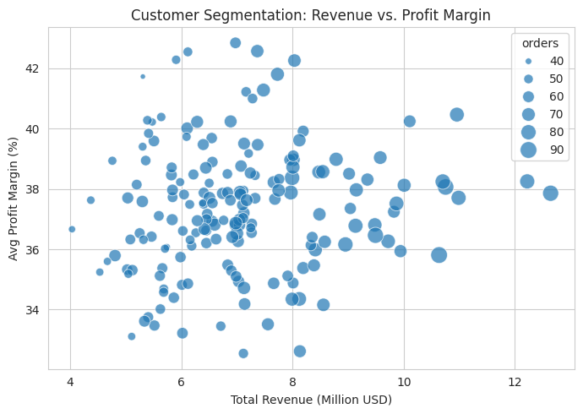
Multivariate Analysis
Findings :-
Customers with >$10 M in revenue tend to sustain margins between 36-40%, indicating that scale does not significantly erode profitability.
Most customers cluster within the $6-10M range and show stable margins (~34-40%), suggesting consistent pricing in this tier.
Customers below $6M display the widest margin variance (~33-43%), pointing to more volatile cost structures or discounts among smaller accounts.
Bubble size (order count) increases with revenue, but margin levels appear unaffected – reinforcing revenue as the dominant performance driver over order volume.

Slide 15
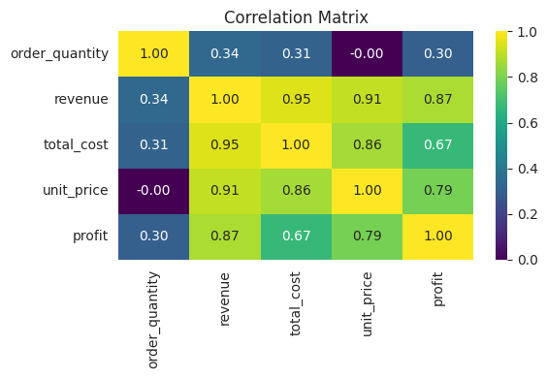
Multivariate Analysis
Findings :-
Profit and revenue are very strongly corelated (0.87), indicating that as sales value increases, profit tends to rise as well.
Unit price is a key diver: it correlates 0.91 with revenue, 0.79 with profit and 0.94 with cost – highlighting how pricing decisions ripple through both top-line and expense figures.
Cost shows a strong link to revenue (0.85) but a more moderate tie to profit (0.58), underscoring that while higher sales often bring higher expenses, margins can still vary.
Quantity has virtually no corelation with unit price or cost (~0.00) and only modest associations with revenue (0.34) and profit (0.30), making volume a secondary factor compared to pricing.

Slide 16
-:Key Insights:-
Monthly Revenue Cycle:-
Revenue stays stable between ~$23M-$26.5M across 2021-2024, with no consistent seasonal spikes. Sharpest drop (~$21.2M) occurs in early 2024, indicating a possible one-time disruption.
Channel Mix:-
Wholesale: 54%. Distributors: 31%. Export:15% - opportunity to scale international presence.
Top Products (Revenue):-
Product 26: $118M; Product 25: $110M; Product 13: $78M. Mid-tier: $68-75M; bottom performers: $52-57M.
Profit Margins:-
Profit margins range broadly from ~18% to~60%, with no strong correlation to unit price. Dense horizontal bands suggest standardized pricing strategies across tiers.

Slide 17
-:Key Insights:-
Seasonal Volume:-
No strong monthly pattern, but slight volume uptick appears around May – June. Early 2024 dip (~$21.2M) may require investigation.
Regional Performance:-
California leads: ~$230M Revenue & 7500+ orders. Illinois/Florida/Texas: ~$85M-$110M & ~3500-4500 orders. NY/Indiana: ~$54M & 2000+ orders.

Slide 18
-:Recommendations:-
Outlier Strategy: Exclude or formalize bulk-order and promotional SKUs when calculating averages.
Margin Uplift: Apply top-product pricing levers to mid/low tiers; cut costs on underperformers.
Export Growth: Invest in targeted overseas marketing and distributor partnerships.
Seasonal Planning: Shift spend towards January through and May-June peak; investigate the 2024 anomaly.
Dashboard Prep: Build aggregated tables for time series, channel mix, and product performance for Power BI.

Slide 19
-:THANK YOU:-

